Slide 1
Control it like IaaS, scale it like PaaS
RootConf 2017
Ritesh Modi
Senior Technology Evangelist
Microsoft

Slide 2
IN THIS Session
What are Virtual machine Scale Sets?
Advantages and importance of VMSS?
Building a Scale Set using template
Scale & Autoscale
monitoring and Upgrading
Load Balancing a Scale Set
Operational validation of a scale Set

Slide 3
What are Virtual machine Scale Sets

Slide 4





Compute requirements of a modern cloud app
Transparent, automatic, rapid scale
Simple manageability
High availability
Security - Patching / upgrades
Load Balancing
Compute nodes
Control nodes
Availability Set
Availability Set
Virtual Network

Slide 5
Open Choice at Every Layer
Mobile
Apps
Web Apps
Mobile
Apps
Web Apps
Vertical Compute PaaS
Vertical Compute PaaS
App Service
App Service
Media
Media
Media
General Compute PaaS
General Compute PaaS
Apprenda, CloudFoundry
OpenShift, Jelastic, Marathon
Apprenda, CloudFoundry
OpenShift, Jelastic, Marathon
HDInsight
Service Fabric
(VMs and Containers)
Batch
HDInsight
Service Fabric
(VMs and Containers)
Batch
Batch
SCALR, RightScale,
Mesos, Swarm
SCALR, RightScale,
Mesos, Swarm
Cluster Orchestration
SCALR, RightScale,
Mesos, Swarm
VM Extensions
VM Extensions
VM Extensions
IaaS and IaaS+
IaaS and IaaS+
VMs and VM Scale Sets
VMs and VM Scale Sets
VMs and VM Scale Sets
Azure Public Cloud
Azure Public Cloud
Infrastructure
Azure Public Cloud
Infrastructure
Azure Pack Private Cloud
Azure Stack Private Cloud

Slide 6
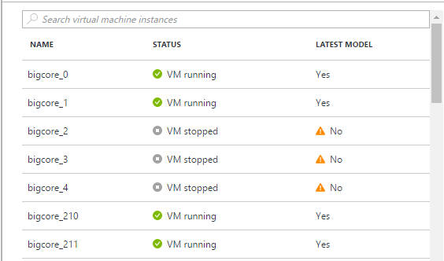
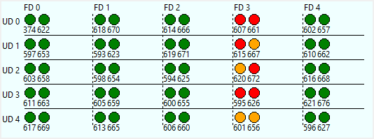
VM Scale Sets provide
Scale - Deploy identical resources
Easily
Rapidly
At scale.. 10s – 10,000s of cores
Customization – PaaS-like ease of use with custom infrastructure requirements
Availability - Roll out updates without service interruption
Low cost - Dynamically increase/decrease compute power to optimize costs
Elasticity - Automatically scale to changing demand
https://azure.microsoft.com/en-us/documentation/services/virtual-machines-scale-sets/

Slide 7
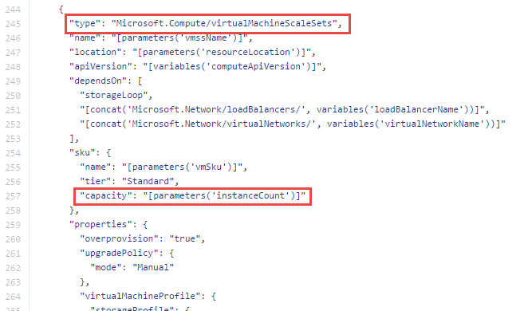
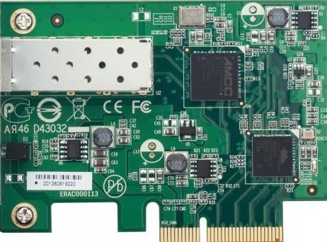


VM Scale Sets in Azure Resource Manager
Resource Group
VNet
Scale Set
Subnet
VM
VM
VM
VM
…
Scalable NIC
Scalable Storage
Extensions
https://github.com/Azure/azure-quickstart-templates - *vmss*

Slide 8
Building a Scale Set using template

Slide 9
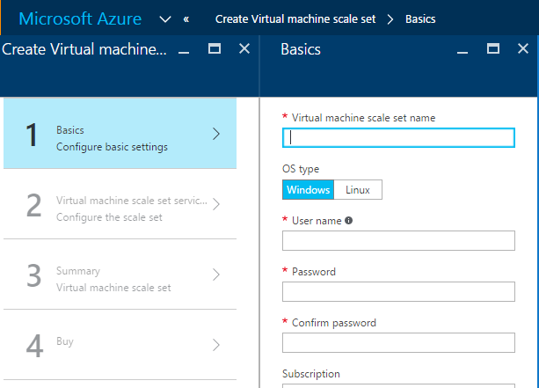
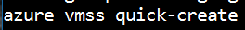
Deploying a scale set
Directly in the portal
From the command line
Use a template
Launch from github, command, SDK etc.
SDK/REST
Consider in context of application...

Slide 10
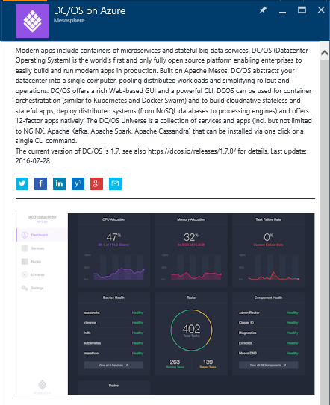





App deployment: Marketplace
Deploy off the shelf Marketplace solution
Predesigned infrastructure
E.g. Mesosphere DC/OS, Brocade, ACS, Service Fabric, Batch (Linux)

Slide 11
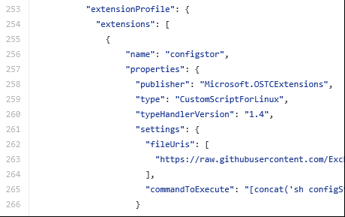
App deployment: VM Extensions
Run custom scripts or off the shelf extensions
Define with initial scale set deployment or add to existing infrastructure
Roll out extension updates like OS updates

Slide 12
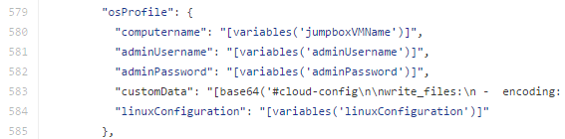
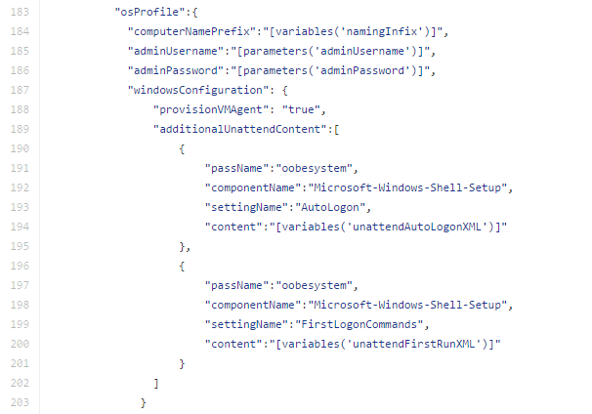
App deployment: customData/unattend
Deployment script encapsulated directly in VMSS properties
No dependency on external network connectivity

Slide 13
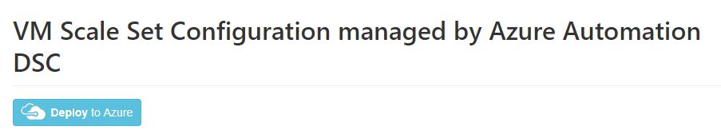
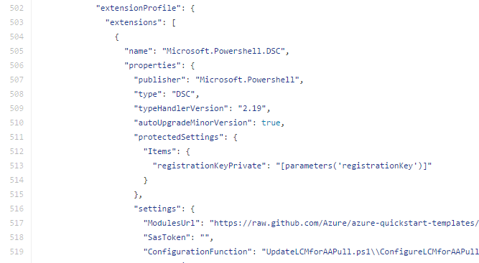
App deployment: Configuration Management
VMs register as nodes with configuration management host
Host maintains app consistency on nodes
Config manager handles complex app deployment requirements (e.g. reboots, dependencies)

Slide 14
App deployment: Containerized
Scale set is stable, scalable infrastructure
App containers managed independently of infrastructure
Application Orchestration
Containers
OS (Windows/Linux)
Infrastructure - VMSS

Slide 15
Load Balancer

Slide 16
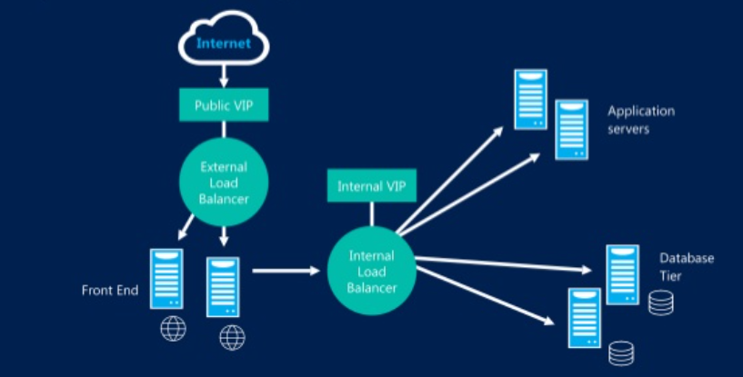

Slide 17
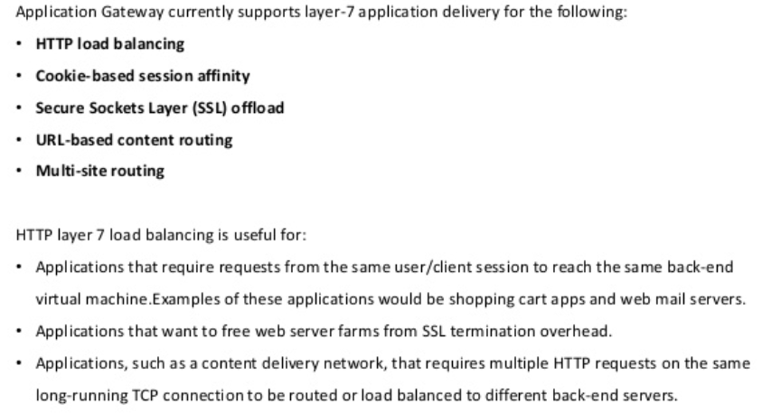
Application Gateway

Slide 18






App deployment: custom image
Trigger Build
Dev checks in code
Build app
Test
Stage
Production
Bake app into image
Packer
Reuse the same image across stages
http://www.slideshare.net/LarryGuger/spinnaker-for-azure

Slide 19

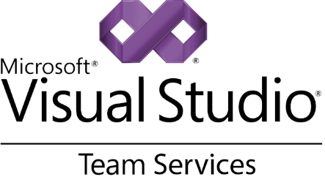
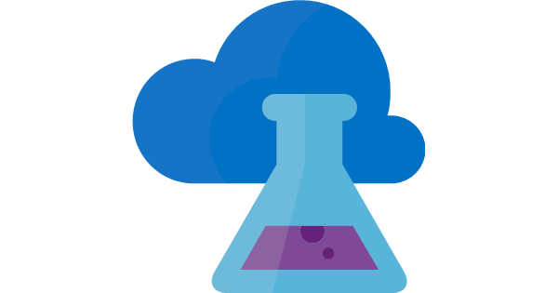
App deployment: custom image
Dev checks in code
BUILD
RELEASE
Test
Stage
Production
PACKAGE
Bake app into image
Azure DevTest Labs
Used as “Golden Image” Bakery
Reuse the same
“Golden Image” across stages
https://azure.microsoft.com/en-us/services/devtest-lab/

Slide 20
VMSS app deployment example
On demand high perf MRI image reconstruction
Real time imaging is compute intensive
VMSS based bursting solution
Capacity increased as new scans requested
Add 8 nodes in ~3 mins
Automatic shutdown timer
capacity: 8->32 VMs
Size: F16
(Compute optimized)
VMSS
D3_V2 VM
Relay node
MRI
Load Balancing
Custom VM images
Custom script extension
Docker container
MRI host
Virtual Network
https://github.com/hansenms/azure_templates

Slide 21
Scale

Slide 22
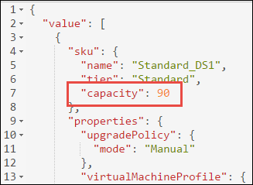
Scaling VM Scale Sets
Horizontal vs. vertical scale
Change the “capacity” property of the scale set
Redeploy
New VMs are spread across UDs, FDs, storage accounts
VM ID increases
VMs deleted by highest ID first

Slide 23
Scaling with PowerShell/CLI
PowerShell
$vmss = Get-AzureRmVmss -ResourceGroupName myvmss -VMScaleSetName myvmss
$vmss.Sku.Capacity = 10
Update-AzureRmVmss -ResourceGroupName myvmss -Name myvmss -VirtualMachineScaleSet $vmss
CLI
user@myvm: azure vmss scale –g rgname –n vmssname –C 10
Note: Use any tool which edits VMSS model (e.g. Resource Explorer)
Portal integration coming soon..

Slide 24
Autoscale

Slide 25
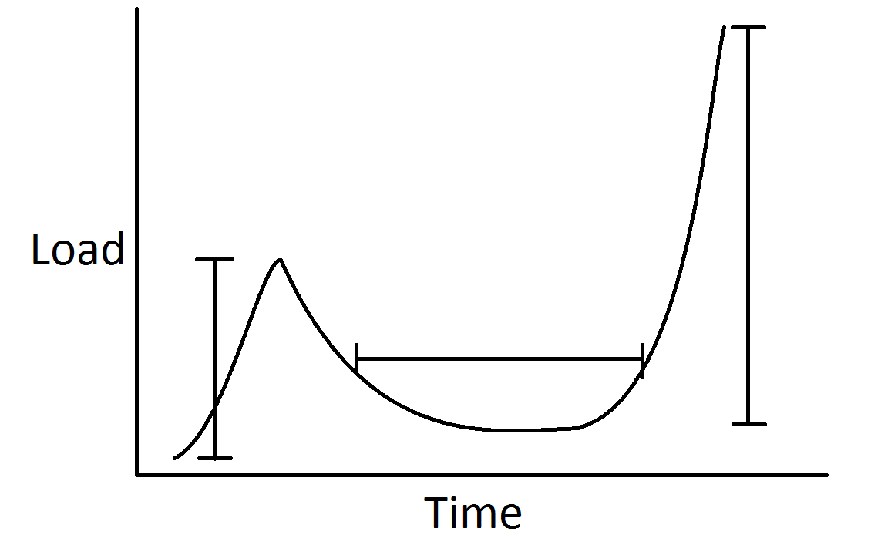
Autoscale: Why do I care?
3) Notifications
1) App Resiliency
2) Reduced Cost

Slide 26
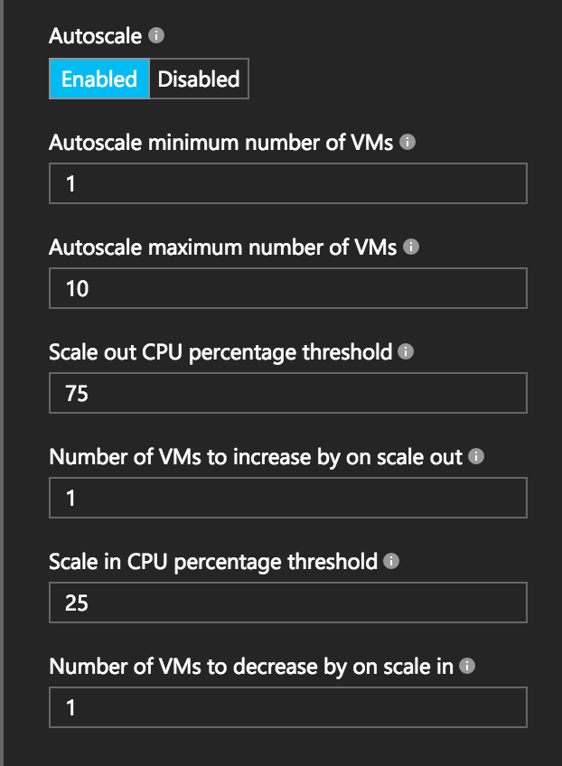
Autoscale: How do I get it?
Portal: get started in a few clicks
Resource Manager Template: have full control
CLI, PowerShell, Resource Explorer, SDKs, etc.
In-VM Agent
Windows Azure Diagnostics agent
Linux Azure Diagnostics agent

Slide 27
Autoscale
Scale Set
VM
VM
VM
WAD
WAD
WAD
capacity = n
WAD metrics
Scale action
6
3
Resource validations/checks
Insights Storage
Portal
Insights REST API calls
ARM/CSM
Monitoring Service
(Insights)
Create/update AutoScale setting
1
2
4
Schedule AutoScale job (runs every 5 minutes)
Insights SDK, PowerShell
AutoScale service
(background job)
5
Job collects metrics for AutoScale rules
Log AutoScale trigger events
Scale action (ask the Resource Provider to scale, via ARM)
https://github.com/Azure/azure-quickstart-templates

Slide 28
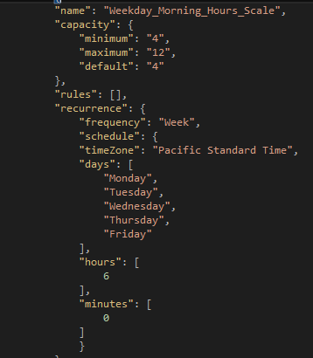
Autoscale: What about complex scenarios?
Simultaneously:
Scale on a specific day
Scale on a recurring schedule
Scale on multiple resource metrics
Defined in Microsoft.Insights Autoscale rules resource

Slide 29
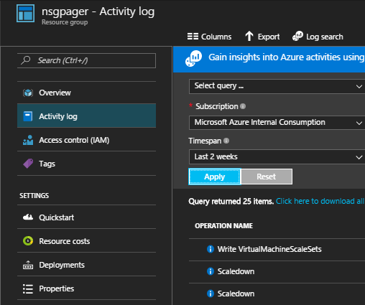
Autoscale: Can I debug it?
See scale events in the Activity Logs
See the underlying data through the REST API
Or Azure Storage Explorer (in-VM metrics only)

Slide 30
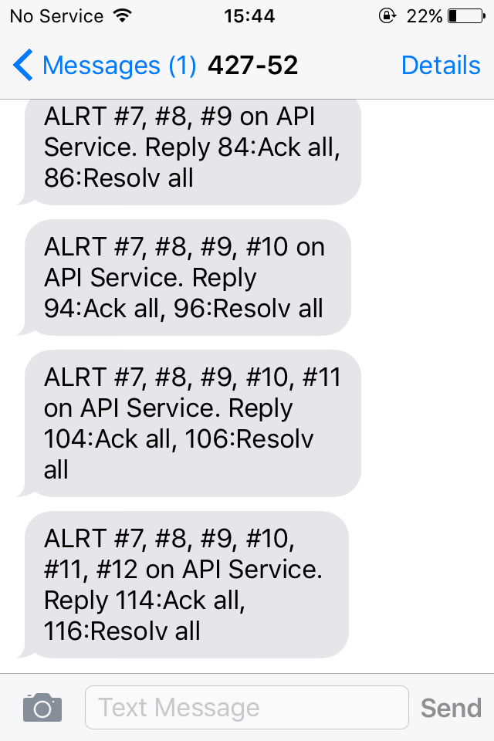
Autoscale: Can Azure notify me?
Auto-email your ops team!
Integrate with external APIs via Event Hooks
Comes with basic payload
Add your own payload

Slide 31
Monitoring & Upgrades

Slide 32
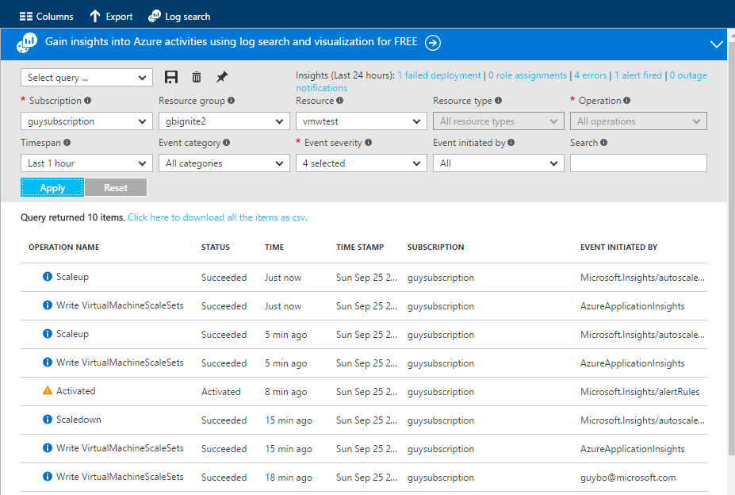
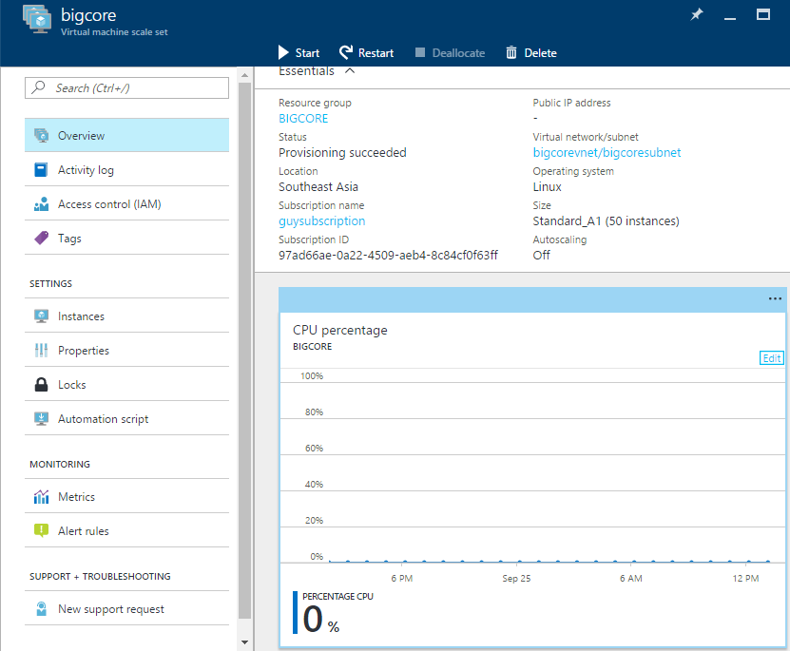
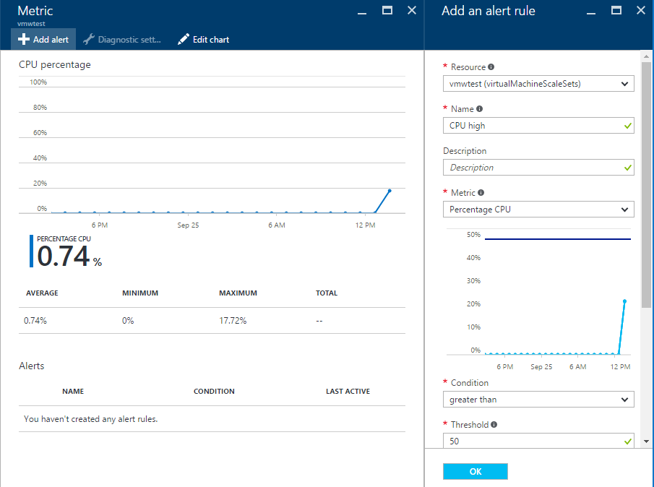
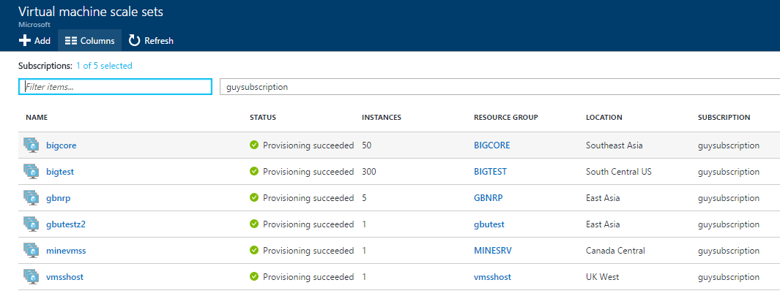
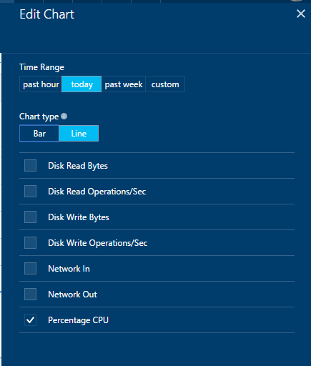
Monitoring - portal

Slide 33
How do you update a scale set?
Application updates
E.g. Configuration manager /container orchestrator
In-guest updates
E.g. Patch extension
SKU
Version
Image URI
VM size
Extensions
VM image updates
Update image reference in model
capacity
...
Upgrade VMs

Slide 34
Next steps
Reference | Link
Creating Virtual Machine Scale Sets using PowerShell cmdlets | https://azure.microsoft.com/en-us/documentation/articles/virtual-machines-windows-vmss-powershell-creating/
Quickly create a scale set using the Azure CLI | https://azure.microsoft.com/en-us/documentation/articles/virtual-machine-scale-sets-cli-quick-create/
Azure Autoscale Best Practices | https://azure.microsoft.com/en-us/documentation/articles/insights-autoscale-best-practices/
Azure Autoscale Emails and Webhooks | https://azure.microsoft.com/en-us/documentation/articles/insights-autoscale-to-webhook-email/
Integrate Pager Duty with Azure Resources | https://www.pagerduty.com/docs/guides/azure-integration-guide/
For VMSS Editor see https://github.com/gbowerman/vmssdashboard

